Slide 1
FITA MALLOWS and
OREO MALLOWS
GROUP MEMBERS:
Camonayan, Gerlan
Maggay, Ralph Lorenz Noel
Blanza, Alyssa Edz Lynette
Dumangeng, Francine Lianna
Manango, Nicole Zhynile
Meneses, Michelle
Torculas, Ma. Erica Louise

Slide 2
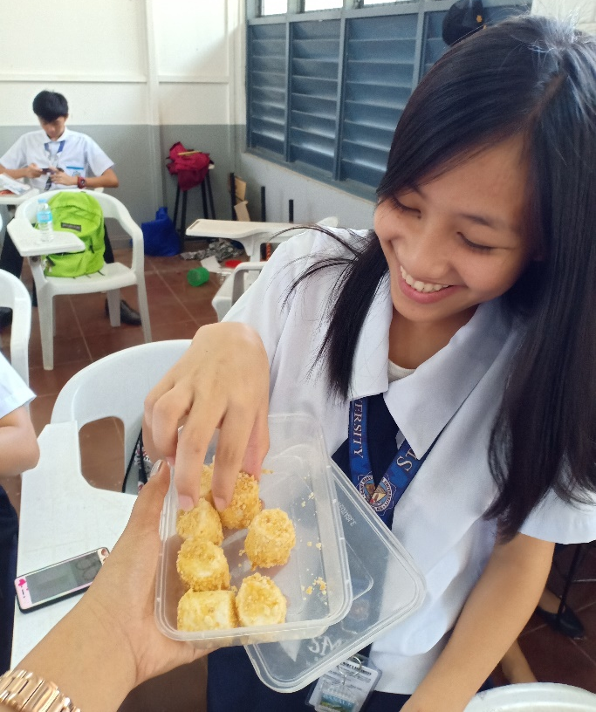
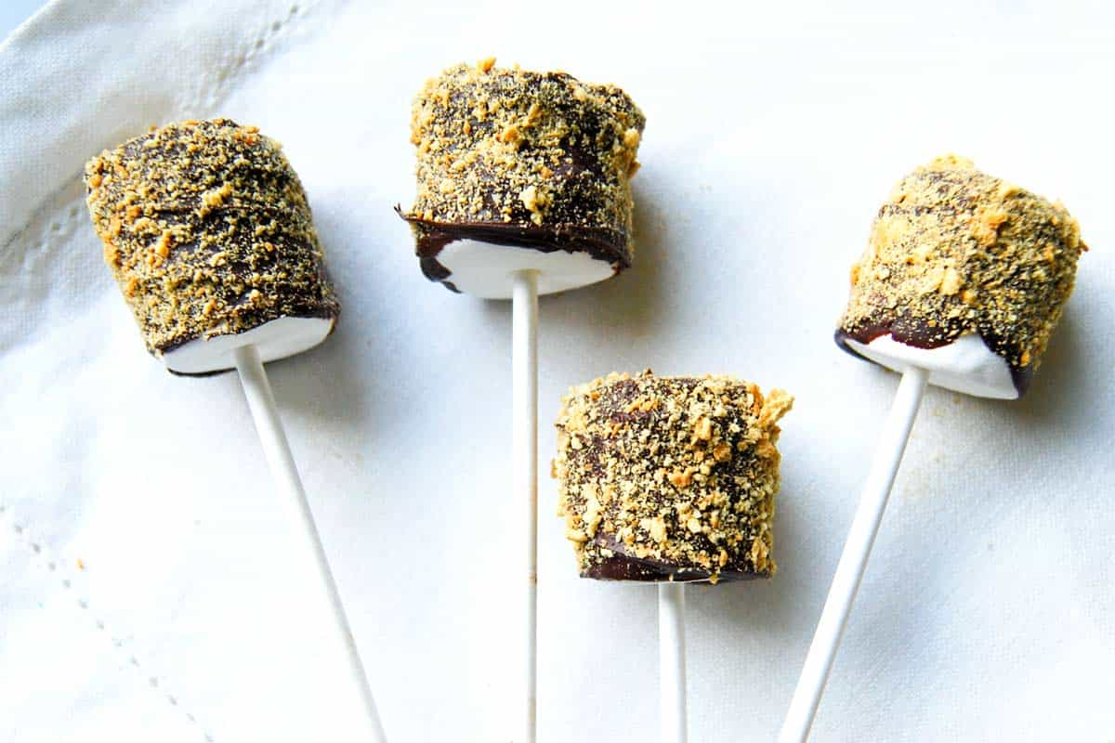
Description about the Product
The product is a classic American treat that has been done in so many fashions. It has an oozing delicious mouth-watering aroma that are super-easy to make for only P4.00 pesos.

Slide 3
Cost of Ingredients
Price
Fita P14.00
Marshmallows P50.00
Oreo P10.00
Condensed Milk P20.00
Water

Slide 4
  TOTAL EXPENSES P94.00
  TOTAL SALE P300.00
  PROFIT P206.00
  PRICE PER PIECE P4.00

Slide 5
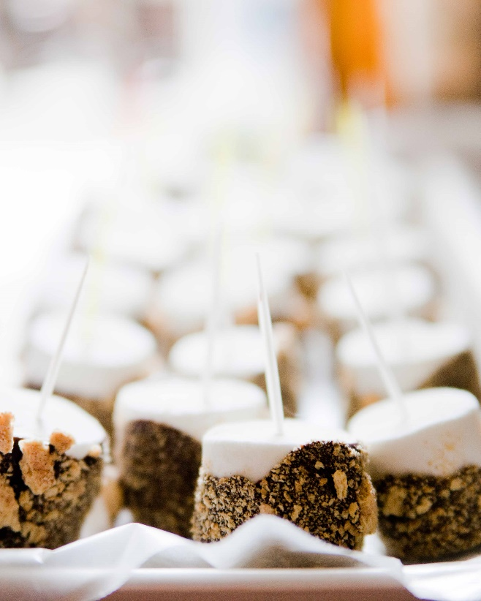
Ingredients
Fita Crackers
Oreo
Marshmallows
Condensed Milk
Water

Slide 6
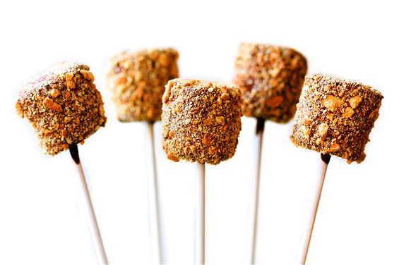
Procedure
Prepare the utensils needed and the ingredients.
Crush the Fita Crackers and the Oreo.
Deep the marshmallows into the condense with little amount of water.
Roll the marshmallows in the crushed crackers.
Chill for few minutes.
Ready to serve.

Slide 7
Survey Result
Survey Result
 |  |  |  |  | In a Scale of 1-5 |  |  |  | YES/NO |  | Price
NO. | Last Name | First Name | Age | Student/Teacher | quality | Taste | Preseation | product | Satisfied? | Recommend? | PHP 15 below | PHP 16-25 | PHP 26-35 | PHP 36-45 | PHP 46-55
1 | Ragasa | Rachelle | 17 | Student | 5 | 5 | 4 | 5 | YES | YES | / | O | O | O | O |  |  | Criteria | Average
2 | Agsundo | Christopher | 18 | Student | 5 | 5 | 5 | 5 | YES | YES | / | O | O | O | O |  |  | Quality | 4.529412
3 | Carbonel | Catherine | 18 | Student | 5 | 5 | 5 | 5 | YES | YES | / | O | O | O | O |  |  | Taste | 4.470588
4 | Millado | Jhovenhel | 18 | Student | 5 | 4 | 4 | 4 | YES | YES | / | O | O | O | O |  |  | Presentation | 4.235294
5 | Gapuz | Ralph | 16 | Student | 5 | 5 | 4 | 5 | YES | YES | / | O | O | O | O |  |  | Product | 4.529412
6 | Marquez | Queenie | 16 | Student | 5 | 5 | 5 | 5 | YES | YES | / | O | O | O | O
7 | Dumapi | Shairah | 16 | Student | 5 | 5 | 4 | 4 | YES | YES | / | O | O | O | O |  |  | Criteria | YES/NO
8 | Binumga | Yulan | 16 | Student | 4 | 4 | 3 | 4 | YES | YES | / | O | O | O | O |  |  | Satisfied? | 17
9 | Castillo | Angelica | 18 | Student | 5 | 5 | 5 | 5 | YES | YES | / | O | O | O | O |  |  | Recommend? | 17
10 | Lumase | Kariza | 17 | Student | 5 | 5 | 5 | 5 | YES | YES | / | O | O | O | O
11 | Bisquera | Xanthene | 16 | Student | 4 | 4 | 4 | 4 | YES | YES | / | O | O | O | O |  |  | Quality
12 | Soliven | Faye | 17 | Student | 5 | 4 | 5 | 4 | YES | YES | / | O | O | O | O |  |  | Teacher | 0
13 | Kristine | Nunez | 16 | Student | 5 | 5 | 5 | 5 | YES | YES | / | O | O | O | O |  |  | Student | 4.529412
14 | Cetra | Bridgette | 16 | Student | 2 | 2 | 2 | 3 | YES | YES | / | O | O | O | O
15 | Cruz | Rikka | 17 | Student | 2 | 3 | 2 | 4 | YES | YES | / | O | O | O | O
16 | Noble | Carlos | 16 | Student | 5 | 5 | 5 | 5 | YES | YES | / | O | O | O | O
17 | Dela Cruz | Charles | 17 | Student | 5 | 5 | 5 | 5 | YES | YES | / | O | O | O | O

Slide 8
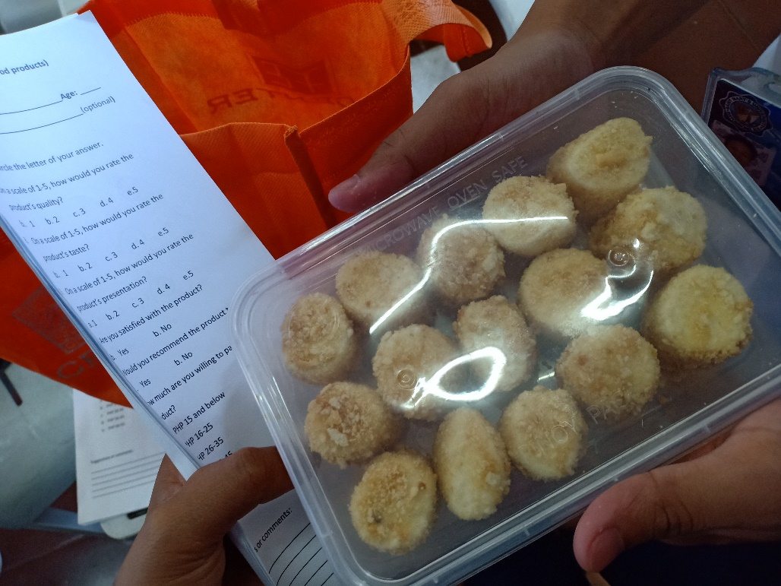

Documentations

Slide 9
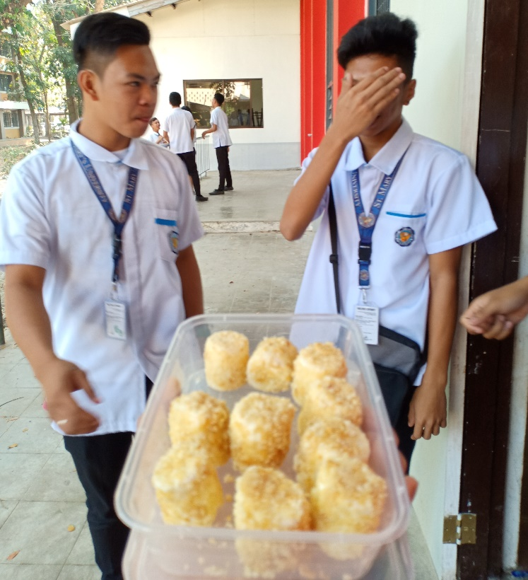
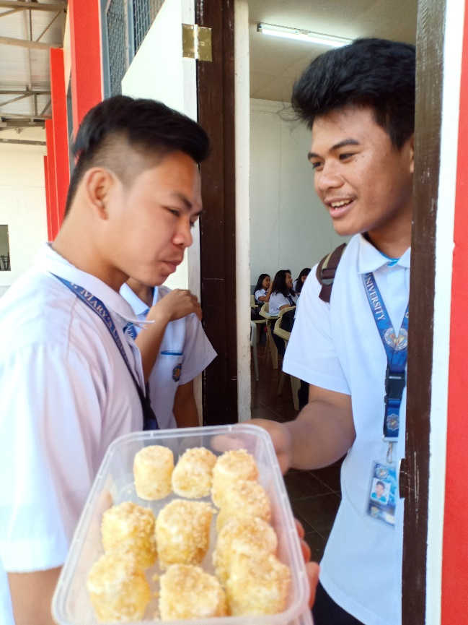
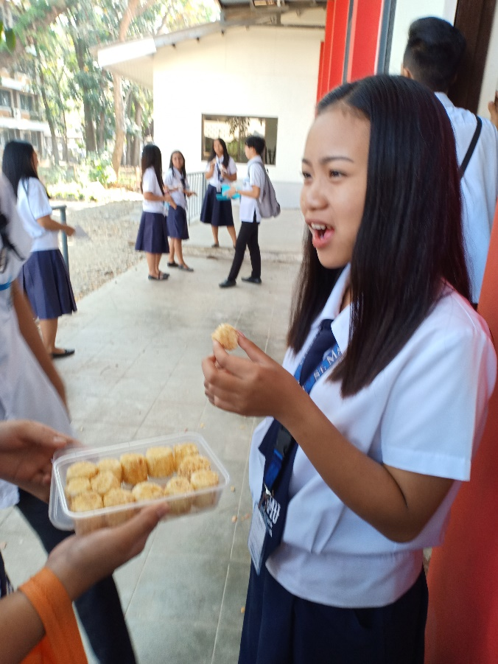
Documentations

